Slide 1


Power Brokers 2022
Winners Social
Media Toolkit

Slide 2


How to use this toolkit
Congratulations on entering the premier group of winners who CoStar applauds for their exceptional accomplishments and hard work. Now more than ever, key recognition and awards are the way professionals are evolving to promote their achievements to their peers and clients. Your accomplishment deserves recognition!
This social media toolkit provides suggested copy that will help you celebrate your success on your own personal or company’s social media channels. Please also consider sharing photos of your trophy or selfies with the award using the official hashtag #CoStarPowerBroker.

Slide 3
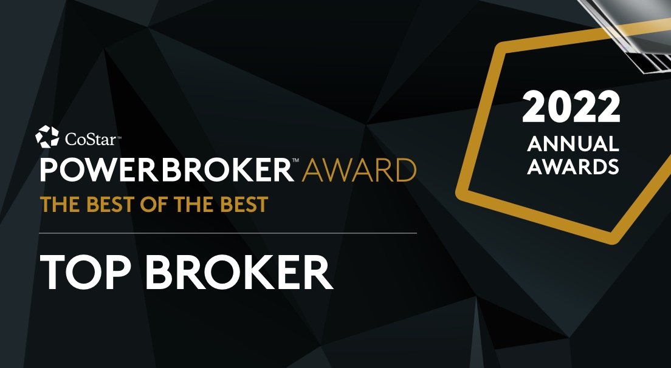
United States – Individual Winners
Suggested text for individual winners to use on LinkedIn, Facebook, Twitter and Instagram
Option 1:
I am honored to be recognized by @CoStarUS as a 2022 #CoStarPowerBroker winner for the (INSERT YOUR MARKET) market!
Learn more about this industry award:
https://www.costarpowerbrokers.com/winners/
Option 2:
I am excited to announce that I’ve been recognized by @CoStarUS as a 2022 #CoStarPowerBroker for closing some of the highest transaction volume in the (INSERT MARKET) market!
Learn more about this industry award:
https://www.costarpowerbrokers.com/winners/
Option 3:
Proud to announce that I’ve been selected by @CoStarUS as a 2022 #CoStarPowerBroker winner for the (INSERT YOUR MARKET) market!
Learn more about this industry award:
https://www.costarpowerbrokers.com/winners/

Slide 4
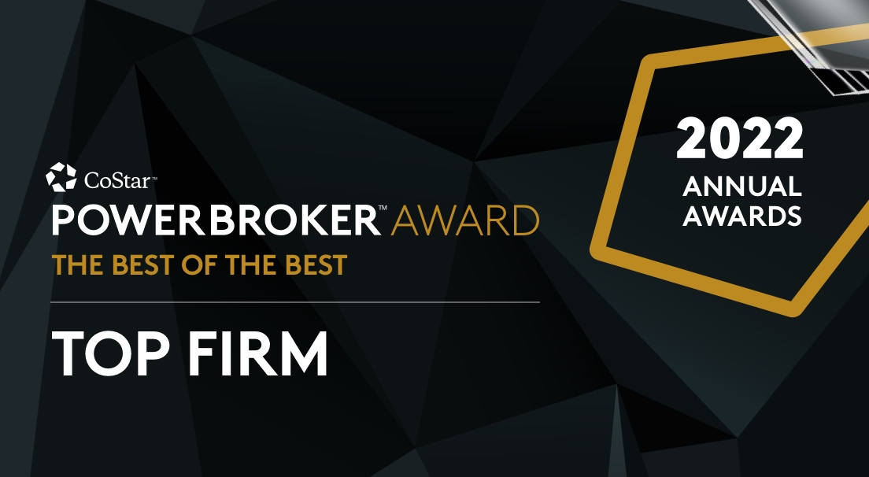
United States – Firm Winners
Suggested text for top firm winners to use on LinkedIn, Facebook, Twitter and Instagram
We’re honored to be recognized by @CoStarUS as a #CoStarPowerBroker Top Firm winner for 2022.
Learn more about this industry award:
https://www.costarpowerbrokers.com/winners/

Slide 5
Canada – Individual Winners
Suggested text for individual winners to use on LinkedIn, Facebook, Twitter and Instagram
Option 1:
I am honoured to be recognized by @CoStarCanada as a 2022 #CoStarPowerBroker winner for the (INSERT YOUR MARKET) market!
Learn more about this industry award:
https://www.costarpowerbrokers.com/winners/
Option 2:
I am excited to announce that I’ve been recognized by @CoStarCanada as a 2022 #CoStarPowerBroker for closing some of the highest transaction volume in the (INSERT MARKET) market!
Learn more about this industry award:
https://www.costarpowerbrokers.com/winners/
Option 3:
Proud to announce that I’ve been selected by @CoStarCanada as a 2022 #CoStarPowerBroker winner for the (INSERT YOUR MARKET) market!
Learn more about this industry award:
https://www.costarpowerbrokers.com/winners/

Slide 6
Canada – Firm Winners
Suggested text for top firm winners to use on LinkedIn, Facebook, Twitter and Instagram
We’re honoured to be recognized by @CoStarCanada as a #CoStarPowerBroker Top Firm winner for 2022.
Learn more about this industry award:
https://www.costarpowerbrokers.com/winners/

